Slide 1
ELUCIDATING DRUG-DRUG INTERACTIONS UNDERLYING DRUG POLYPHARMACY PROFILES
UNIVERSITY OF COPENHAGEN
FACULTY OF HEALTH AND MEDICAL SCIENCES

Slide 2
Summary
Part I Building a compendia of DDIs information from public databases
Part II Comparison between the different data sources: scattered DDI knowledge
Part III Evaluation of the frequency of DDI in clinical practice using Electronic Health Records

Slide 3
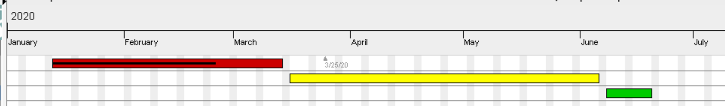
TIMELINE
Reading papers
Extracting and tidying data.
Phase 1; Collecting resources
Phase 2; Computational analysis
Phase 3; TFG

Slide 4
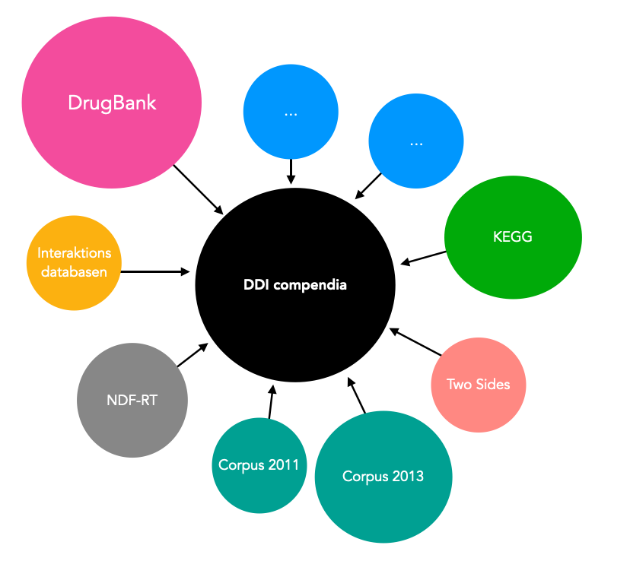
PART I: Building a ddi compendia

Slide 5
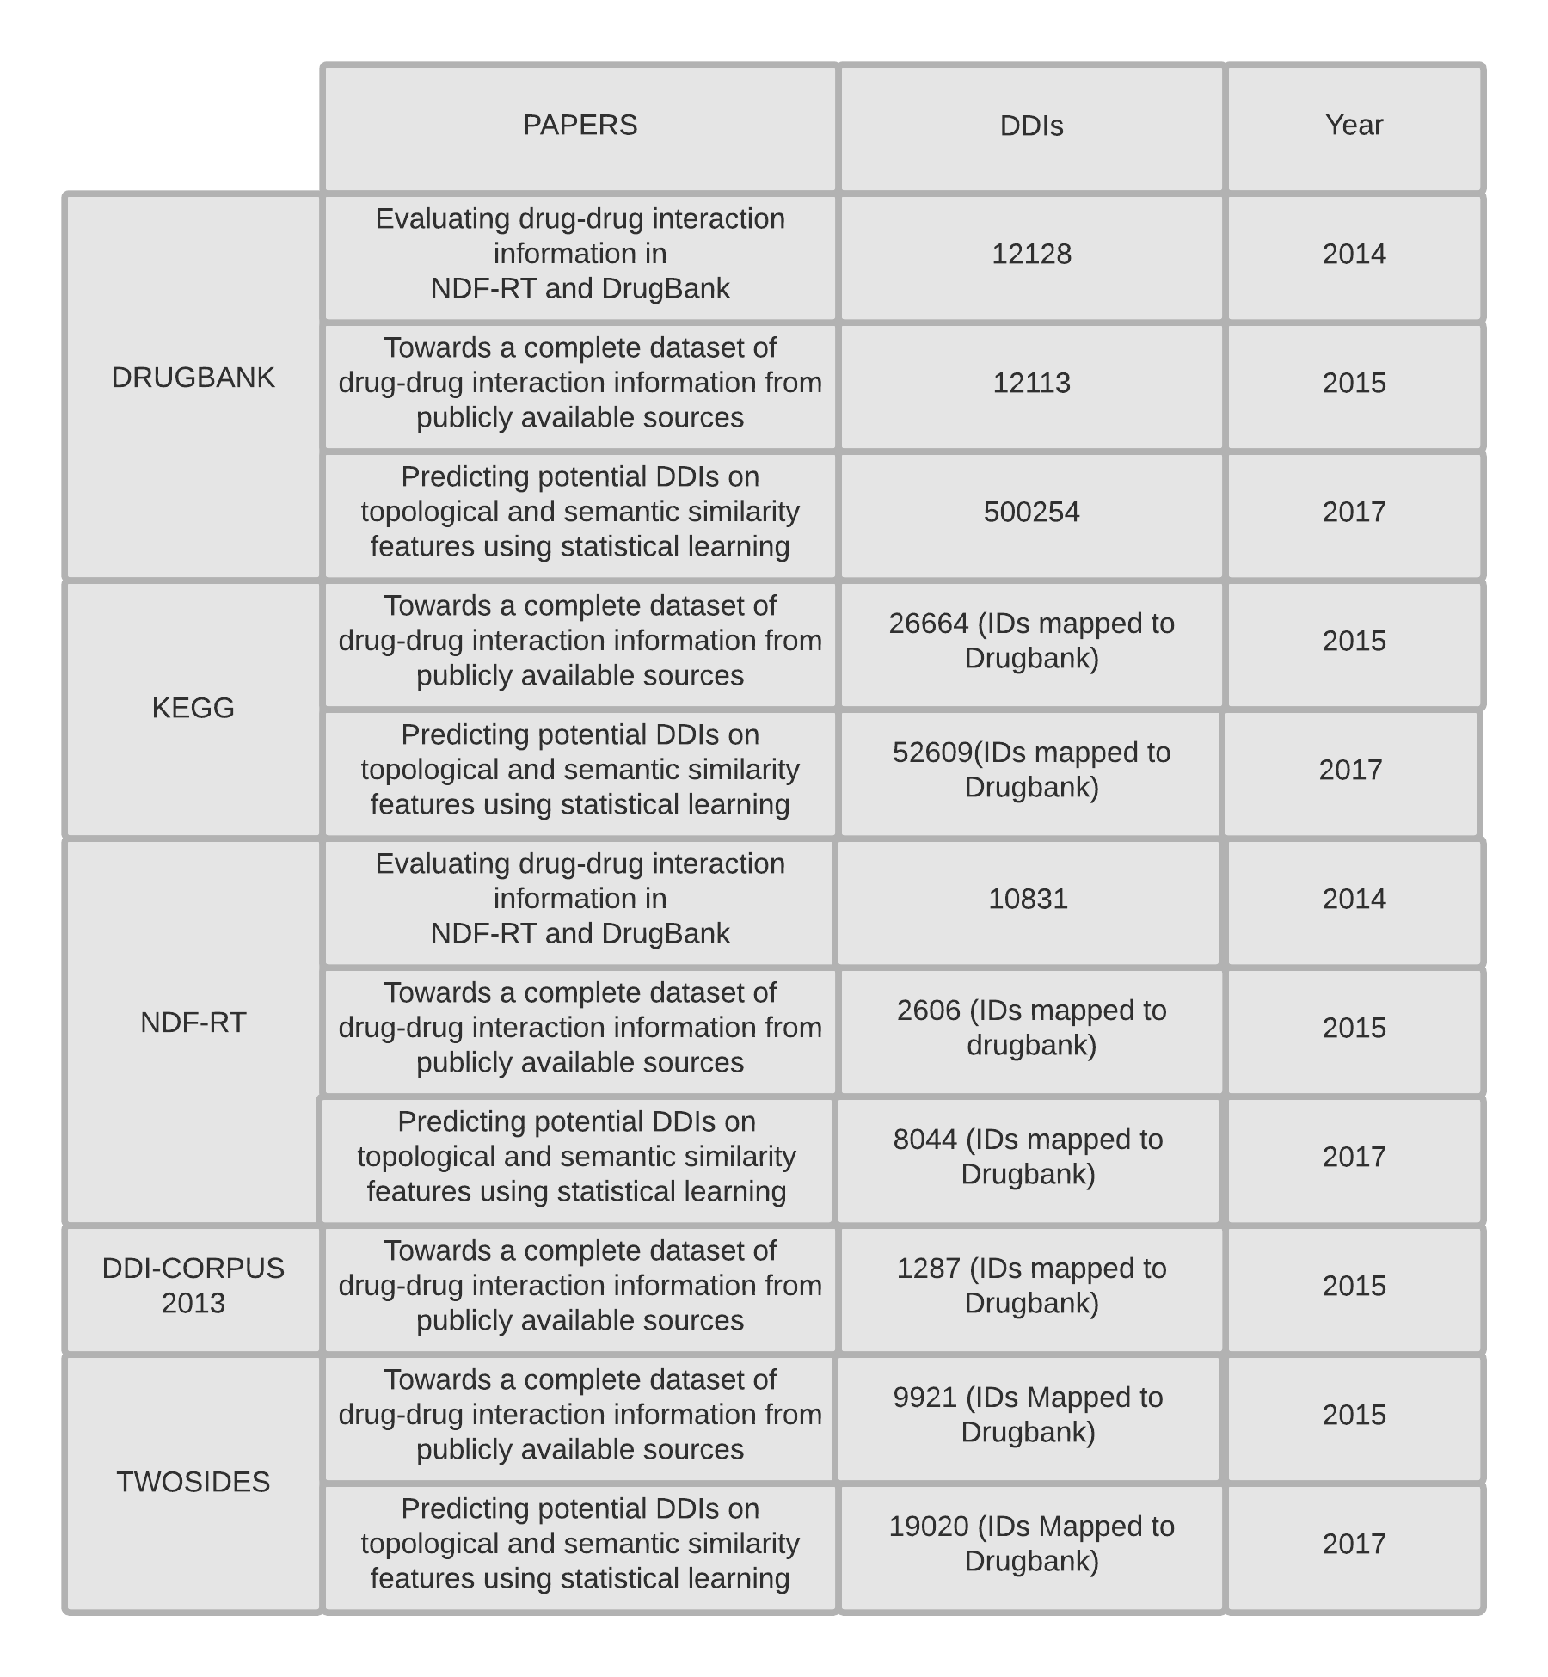

Slide 6
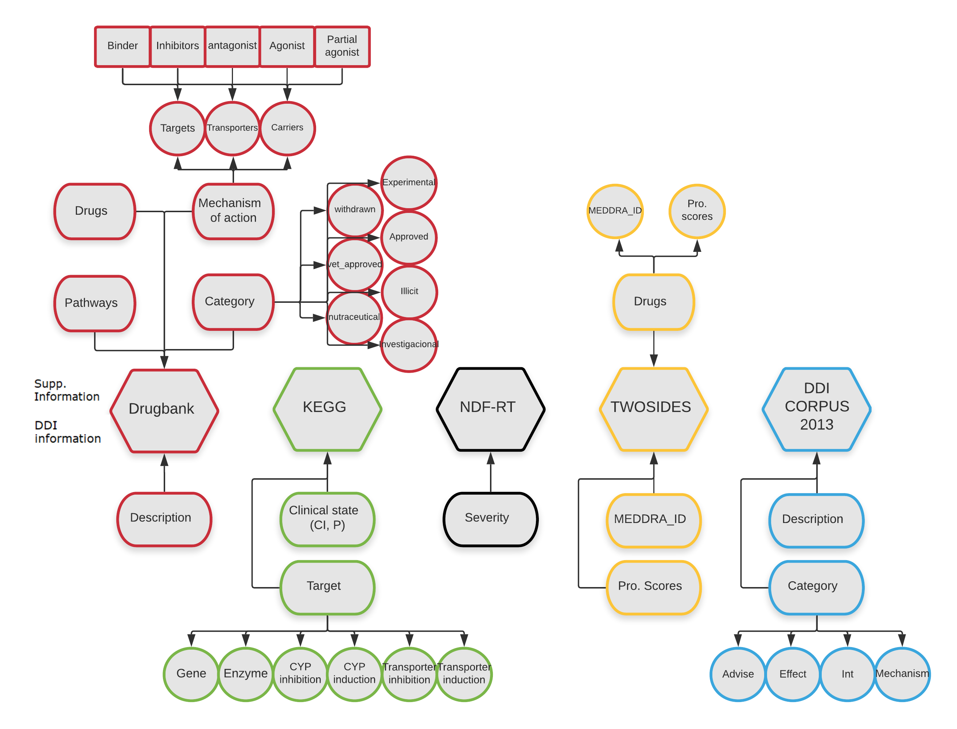


DATA EXTRACTED
 | pathway | category | Mechanism of action | Relaibility score
Drugbank
NDF-RT
TWOSIDE
Restrictions
Each drug must have a Drugbank identifier
Each drug must have an ATC code

Slide 7
PART II: Comparison between sources

Slide 8
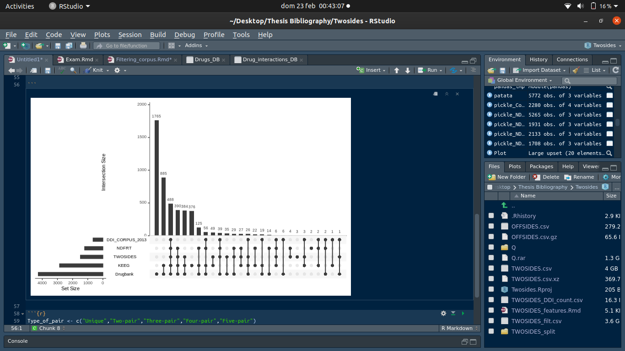
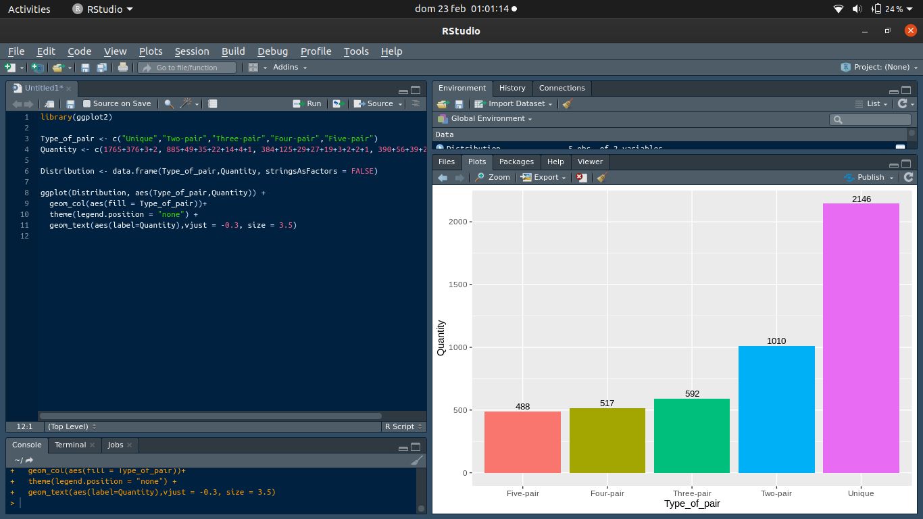

Slide 9
PART III: application to Clinical data

